Slide 1
Interest Point Detectors and Descriptors (LIOP and BRIEF)
By:-
Sameer(2016csb1058) Nitish(2016csb1042)
Notes:
‹#›

Slide 2
Pre-Processing Steps
Image is smoothed by a Gaussian filter with sigma σ_{p} since the relative order is sensitive to noise.
Finding the interest points and affine regions using Harris and Hessian Affine Detectors.
A Gaussian smoothing with sigma σ_{n} is carried out again to remove noise which is introduced by interpolation in the normalization step.

Slide 3
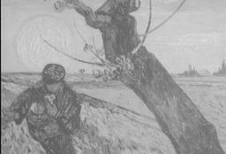
What is an Interest Point?
A point in an image which has a well-defined position and can be robustly detected.
Typically associated with a significant change of one or more image properties simultaneously (e.g., intensity, color, texture).
Corners is a special
case of interest points.

Slide 4


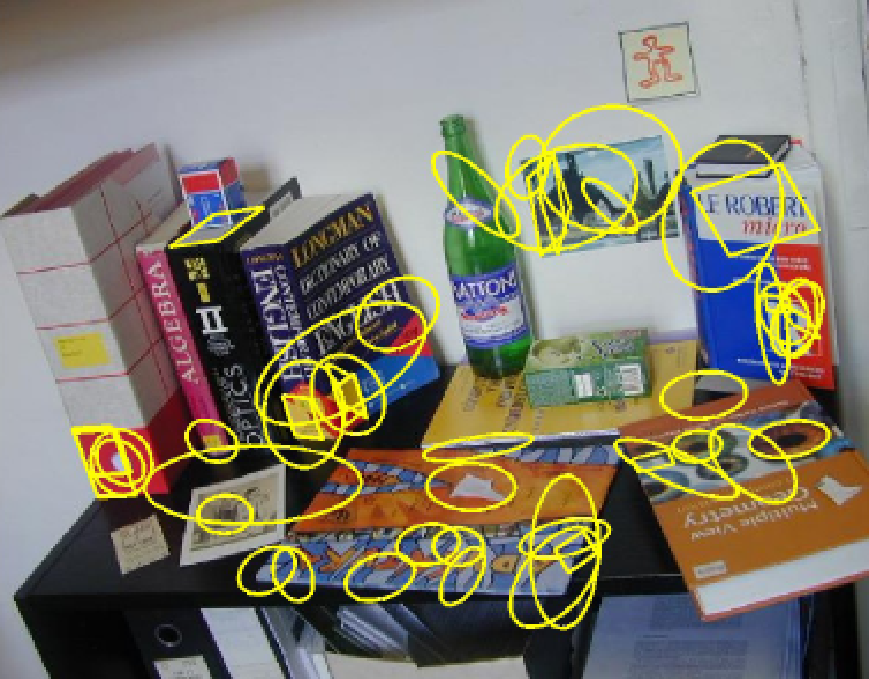
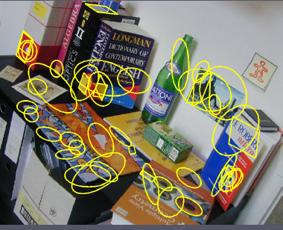

Why are interest points useful?
Could be used to find corresponding points between images which is very useful for numerous applications!
panorama stitching
stereo matching
left camera
right camera

Slide 5
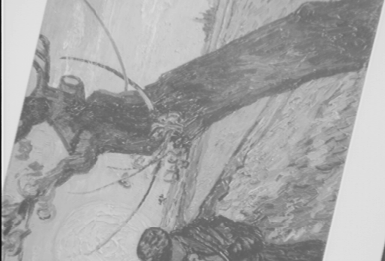
How to find corresponding points?(Feature Descriptor)
?
( )
?
( )
=
feature descriptor
feature descriptor
Look at local neighbourhood of the interest points.
Need to define local patches surrounding the interest points and extract feature descriptors from every patch.
Match feature descriptors to find corresponding points.

Slide 6
Properties of good features
Local: robust to occlusion and clutter.
Accurate: precise localization.
Covariant (geometric or photometric changes invariant).
Robust: noise, blur, compression, etc.
Efficient: close to real-time performance.

Slide 7
Interest point descriptors should be invariant
?
( )
?
( )
=
feature descriptor
feature descriptor
Should be similar despite geometric
or photometric transformations

Slide 8
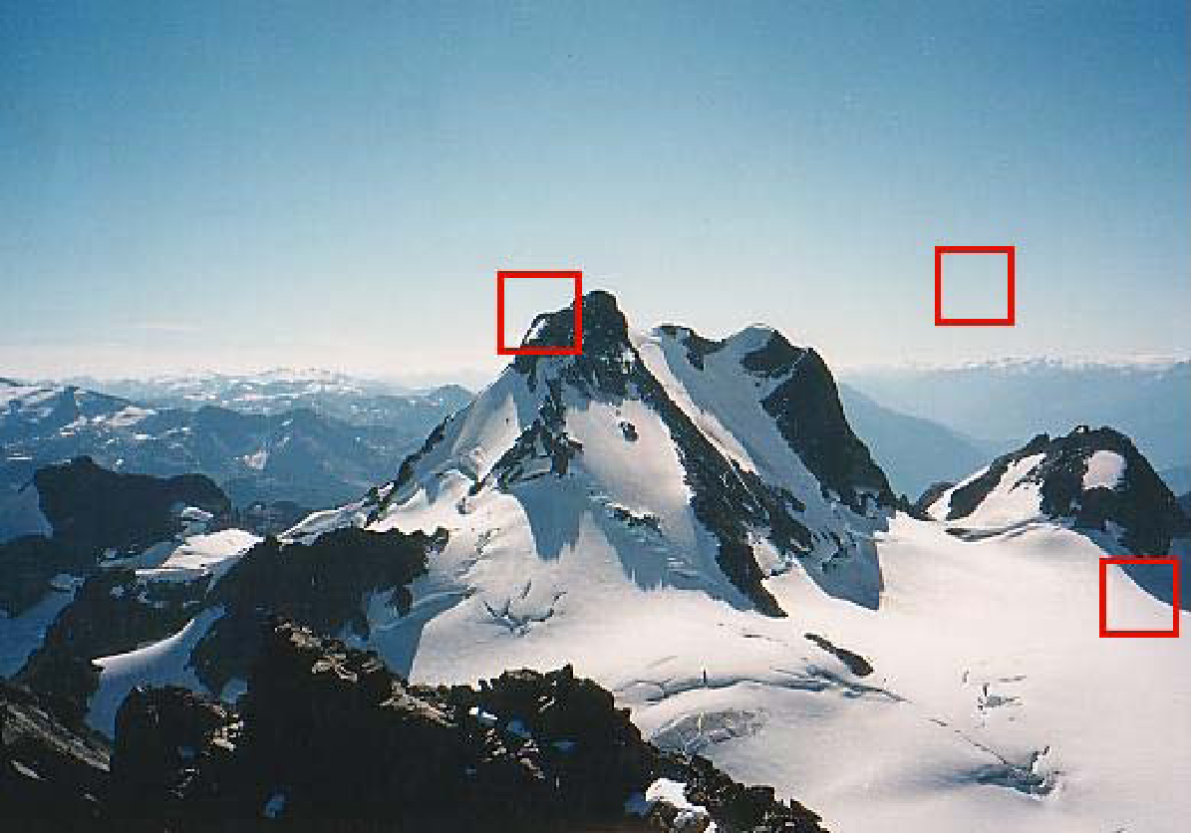
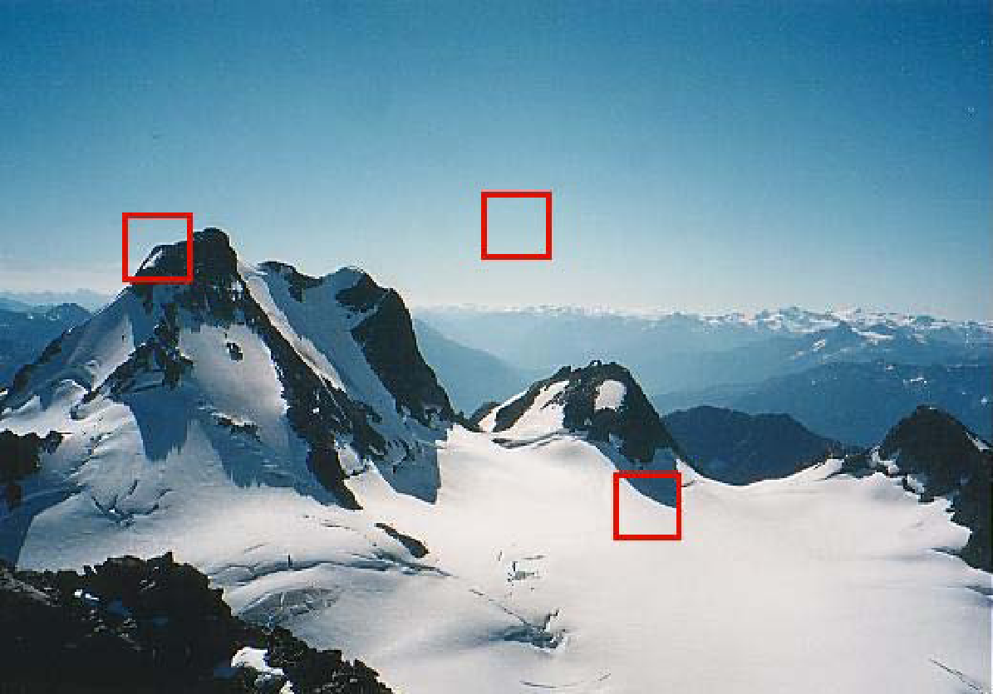


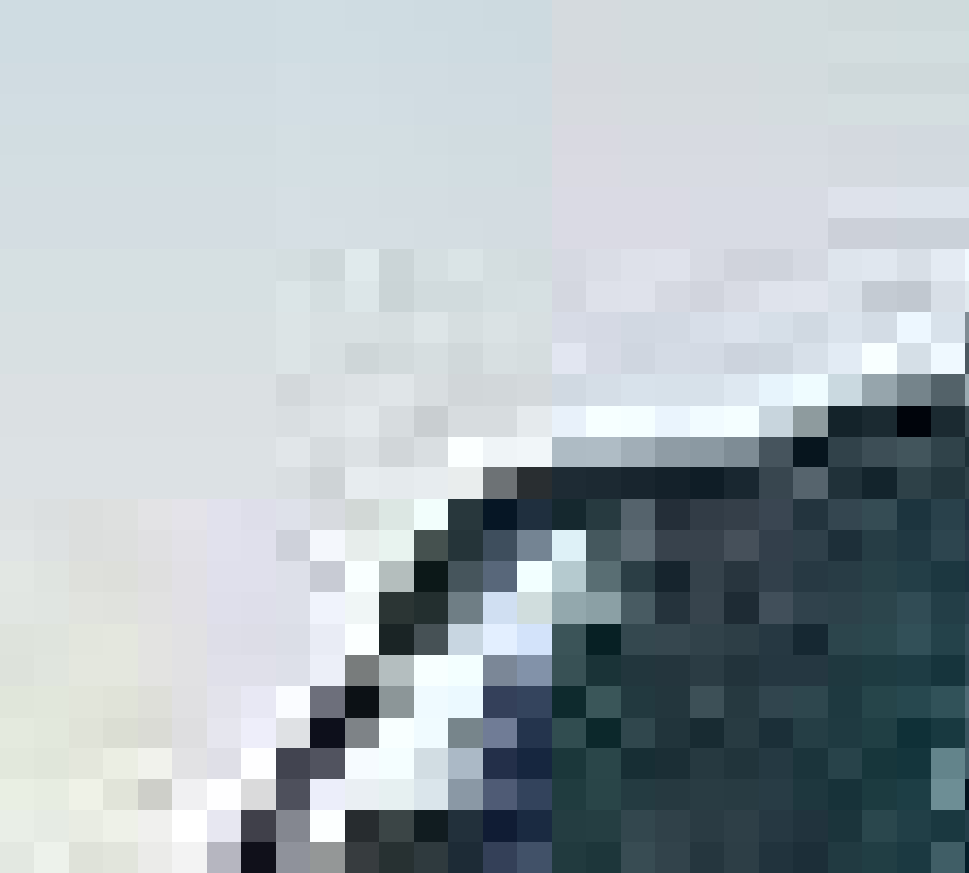


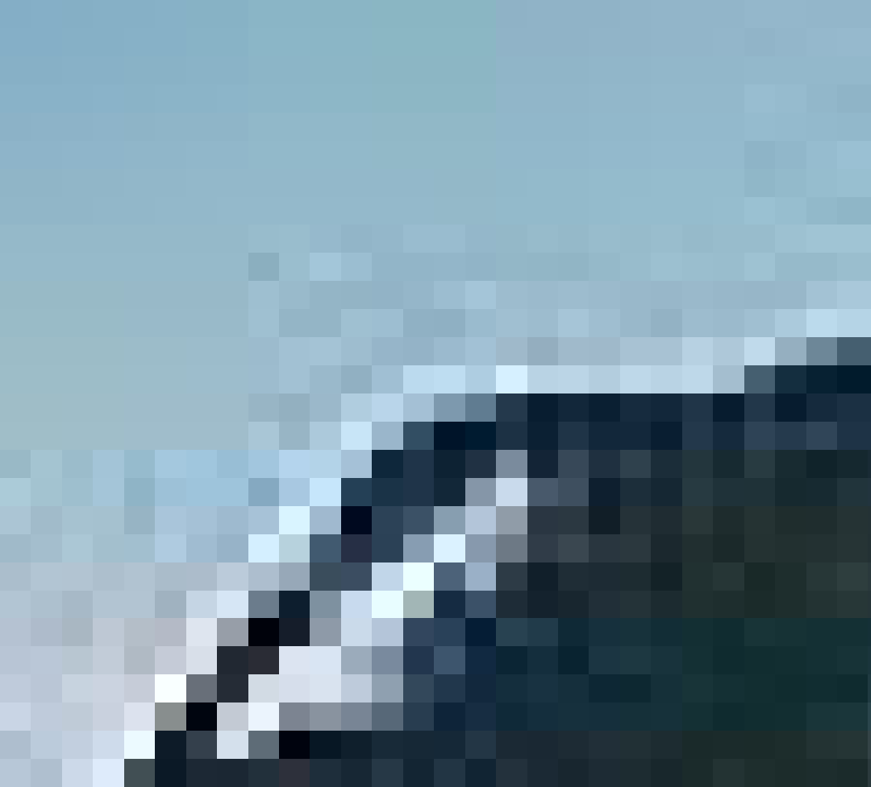
What are Interest point candidates
Use features with gradients in at least two, significantly
different orientations (e.g., corners, junctions etc)
Notes:
‹#›

Slide 9
Feature detection Basic Intiution
Local measure of feature uniqueness
How does the window change when you shift by a small amount?
“flat” region: no change in all directions
“edge”:
no change along the edge direction
“corner”: significant change in all directions
Slide adapted from Darya Frolova, Denis Simakov, Weizmann Institute.

Slide 10
Let’s look at the gradient distributions
I_{y}
I_{y}
I_{y}
I_{x}
I_{x}
I_{xIx}

Slide 11
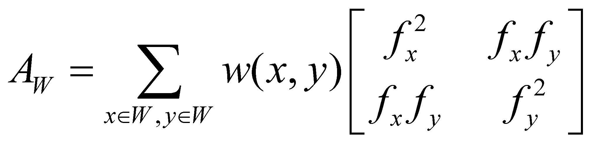
Harris Corner Detector
Assuming a W x W window, it computes the matrix:
A_{W}(x,y) is a 2 x 2 matrix called auto-correlation matrix.
f_{x}, f_{y} are the horizontal and vertical derivatives.
w(x,y) is a smoothing function (e.g., Gaussian)

Slide 12



Why is the auto-correlation matrix useful?
Describes the gradient distribution
(i.e., local structure) inside the
window!

Slide 13
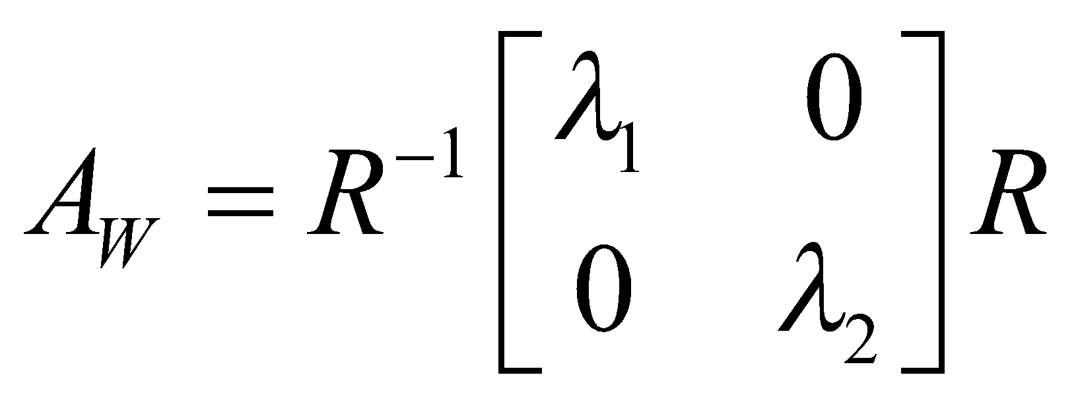
Properties of the auto-correlation matrix
A_{w} is symmetric and can be decomposed :
We can visualize A_{W} as an ellipse with axis lengths and directions determined by its eigenvalues and eigenvectors.
(λ_{min})^{1/2}
(λ_{max})^{1/2}

Slide 14
Harris Corner Detector (cont’d)
The eigenvectors of A_{W} encode direction of intensity change.
The eigenvalues of A_{W} encode strength of intensity change.
v₁
v₂
direction of the slowest change
(λ_{min})^{1/2}
direction of the fastest change
(λ_{max})^{1/2}

Slide 15
Harris Corner Detector (cont’d)
λ₂
“Edge” λ₂ >> λ₁
“Corner” λ₁ and λ₂ are large, λ₁ ~ λ₂; intensity changes in all directions
Classification of pixels using the eigenvalues of A_{W} :
λ₁ and λ₂ are small; intensity is almost
constant in all directions
“Flat” region
“Edge” λ₁ >> λ₂
λ₁

Slide 16
Harris Corner Detector (cont’d)
To avoid computing the eigenvalues explicitly, the Harris detector uses the following function:
R(A_{W}) = det(A_{W}) – α trace²(A_{W})
which is equal to:
R(A_{W}) = λ₁ λ₂- α (λ₁+ λ₂)²
α: is a const

Slide 17
Harris Corner Detector (cont’d)
“Edge” R < 0
Classification of image
points using R(A_{W}):
“Corner” R > 0
R(A_{W}) = det(A_{W}) – α trace²(A_{W})
α: is usually between
0.04 and 0.06
|R| small
“Flat” region
“Edge” R < 0

Slide 18
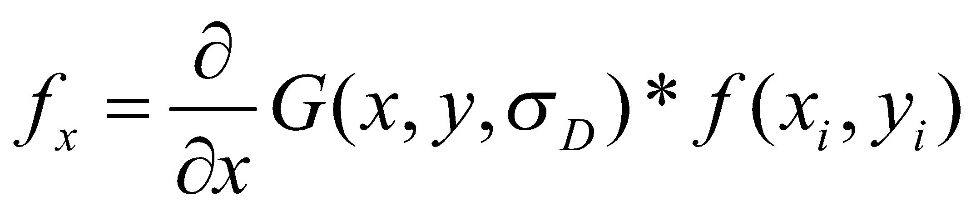
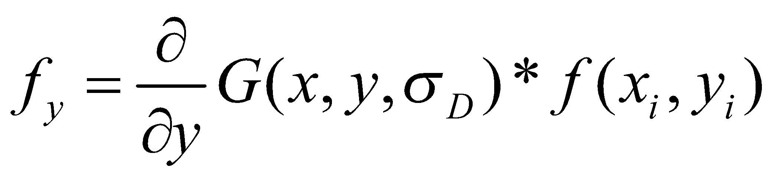
Harris Corner Detector - Steps
Compute the horizontal and vertical (Gaussian) derivatives
σ_{D} is called the “differentiation” scale
2. Compute the three images (f_{x}²,f_{y}² and f_{x}f_{y}) involved in A_{W} :

Slide 19
Harris Detector - Steps
3. Convolve each of the three images with a larger Gaussian
w(x,y) :
σ_{I} is called the “integration” scale
Gaussian
4. Determine cornerns:
R(A_{W}) = det(A_{W}) – α trace²(A_{W})
5. Find local maxima by Non-Maxima Supression.

Slide 20
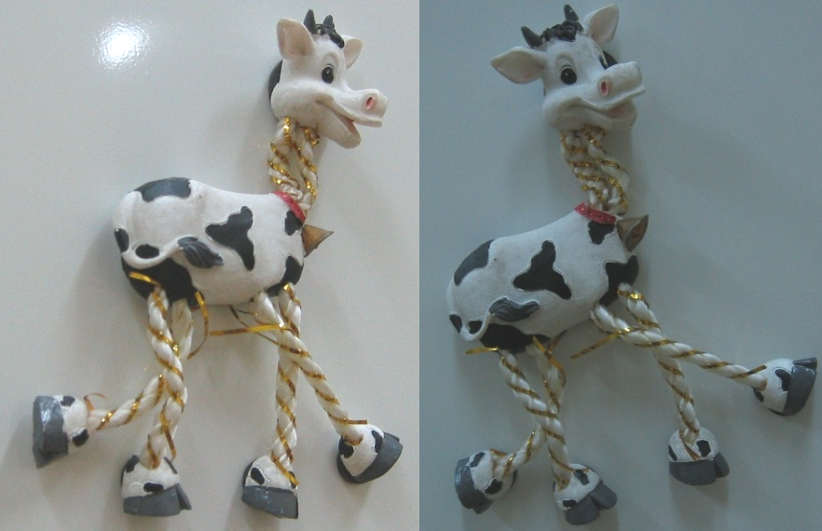
Harris Detector - Example

Slide 21

Compute corner response R

Slide 22

Find points with large corner response: R>threshold

Slide 23
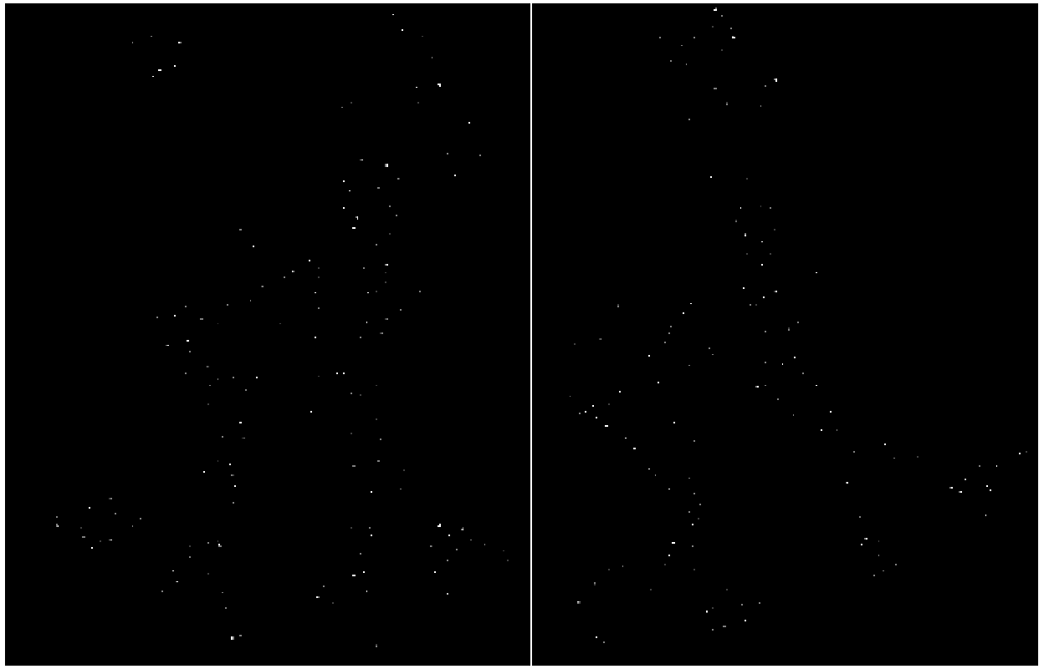
Take only the points of local maxima of R

Slide 24
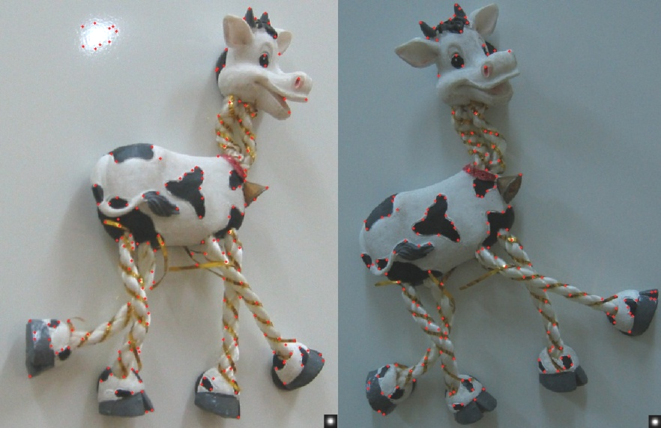
Map corners on the original image (for visualization)

Slide 25
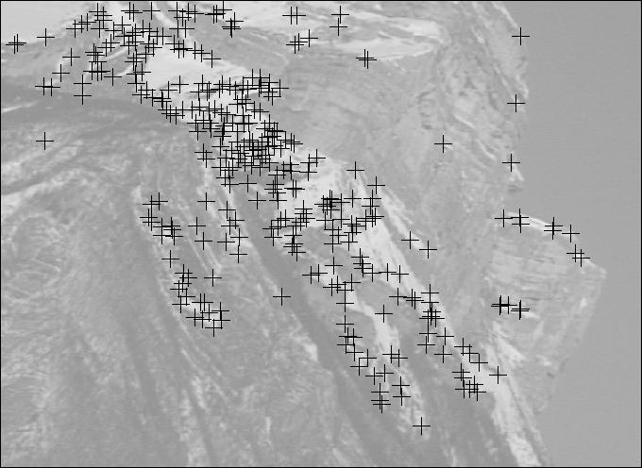
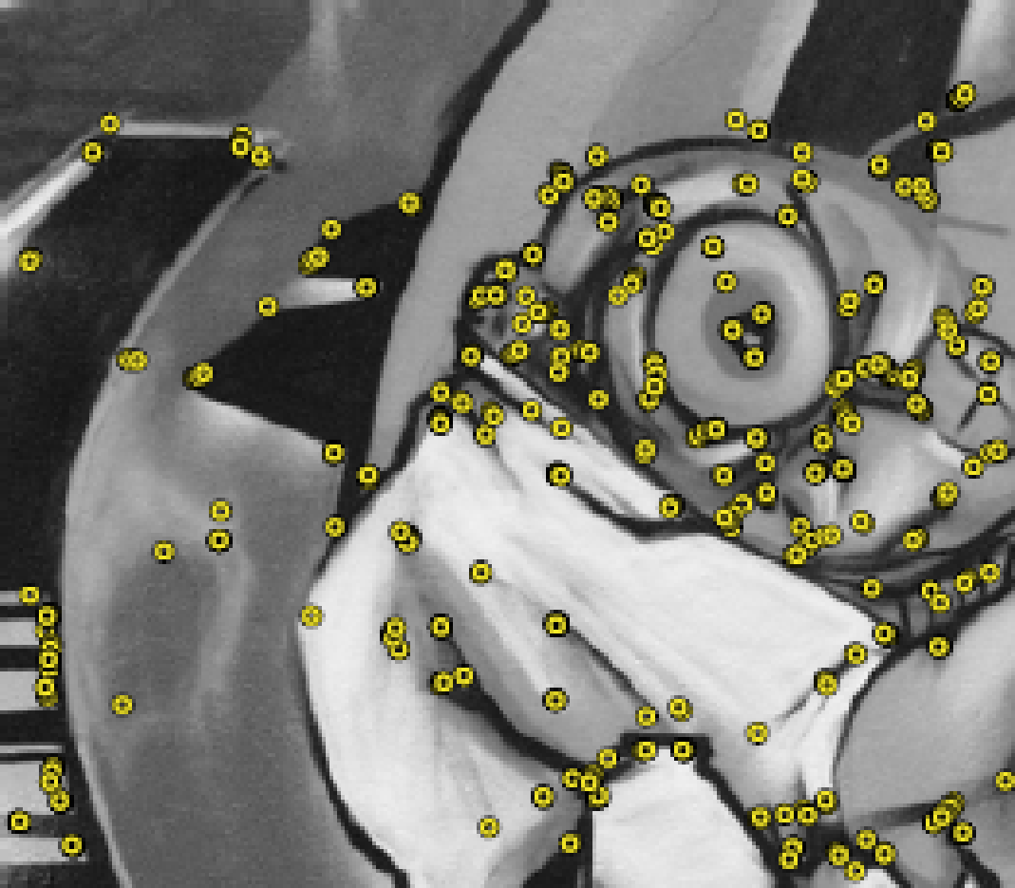
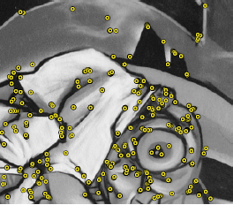
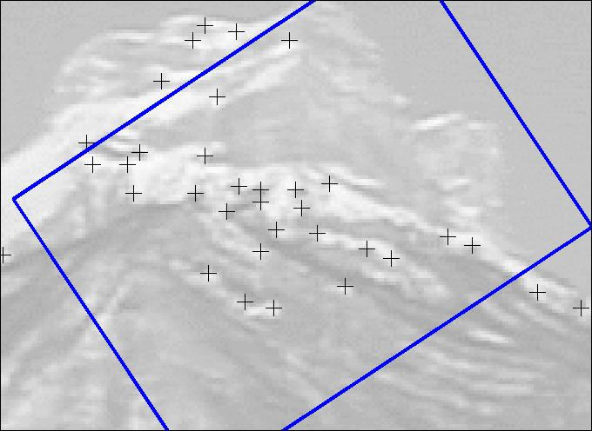
Harris Corner Detector (cont’d)
Rotation invariant
Sensitive to:
Scale change
Significant viewpoint change
Significant contrast change

Slide 26
Solution:-Multi-scale Harris Detector
Detect interest points at varying scales of σ_{D}.
R(A_{W}) = det(A_{W}(x,y,σ_{I},σ_{D})) – α trace²(A_{W}(x,y,σ_{I},σ_{D}))
scale
σ_{n}=k^{n}σ
σ_{n}
σ_{D}= σ_{n}
σ_{I}=γσ_{D}
y
← Harris →
x

Slide 27
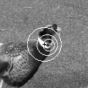
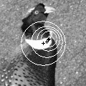
Multi-scale Harris Detector (cont’d)
The same interest point will be detected at multiple consecutive scales.
Interest point location will shift as scale increases (i.e., due to smoothing).
i.e., the size of each circle corresponds to the scale at which the interest point
was detected.

Slide 28
How do we match them for Scale Invariance?
Corresponding features might appear at different scales.
How do we determine these scales?
We need a scale selection mechanism!

Slide 29
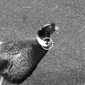
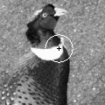
Characteristic Scale
Find the characteristic scale of each feature (i.e., the scale revealing the spatial extent of an interest point or specific to that point).
characteristic scale
characteristic scale

Slide 30
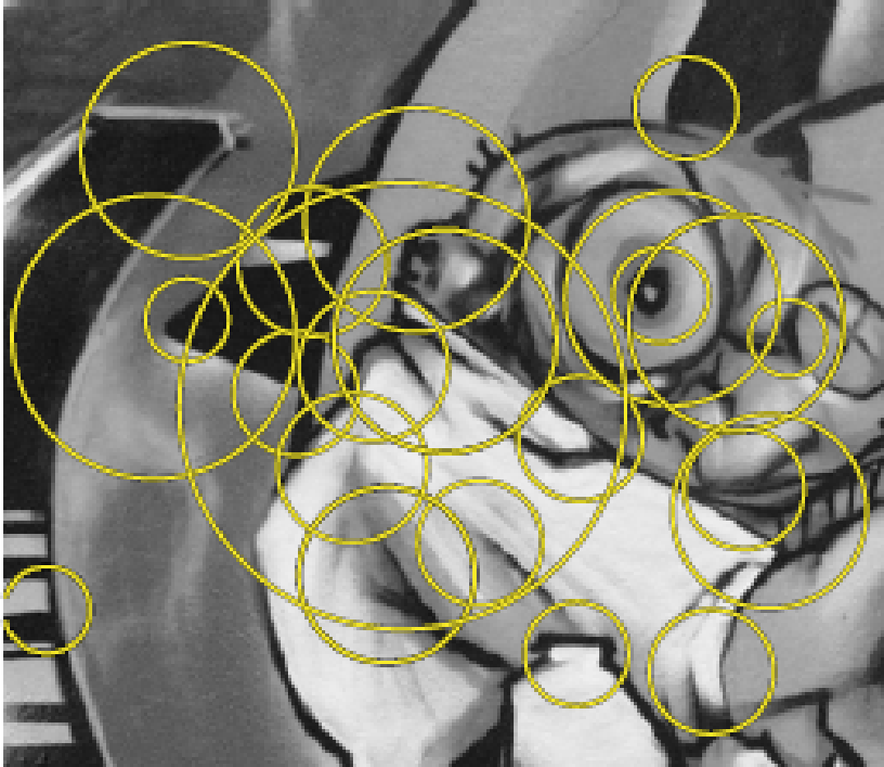
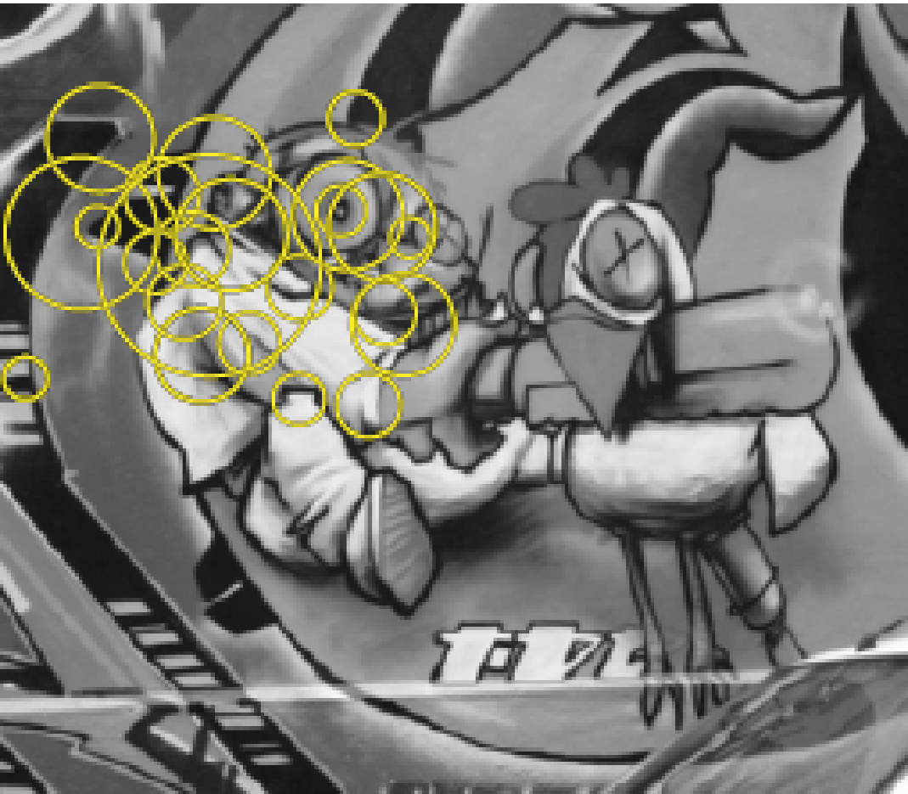
Characteristic Scale (cont’d)
Only a subset of interest points are selected using the characteristic scale of each feature.
i.e., the size of the circles is related to the scale at which the interest points were selected.
Matching can be simplified!
Notes:
‹#›

Slide 31
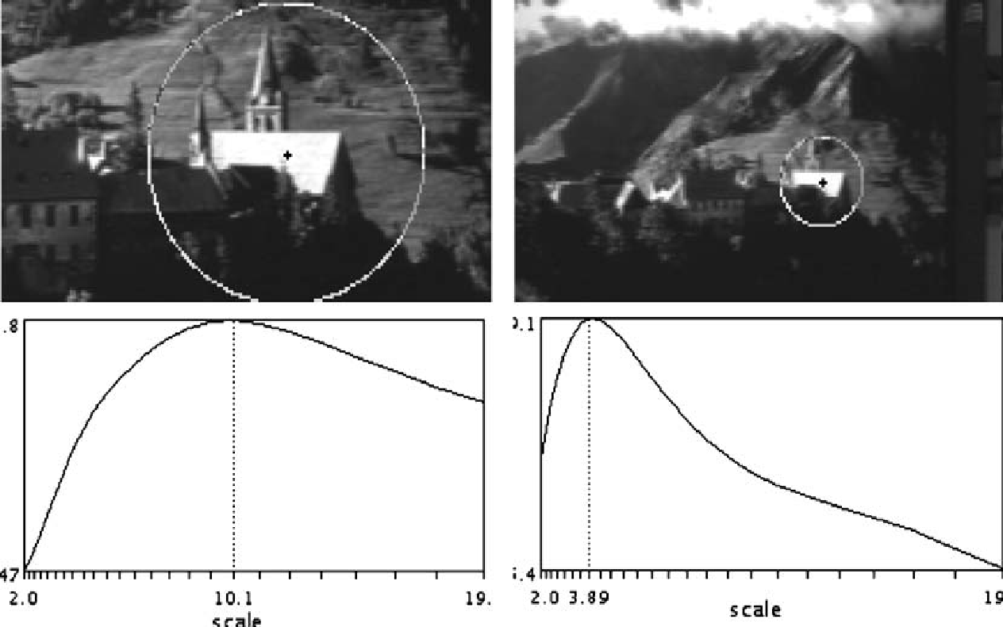
Automatic Scale Selection – Main Idea
Design a function F(x,σ_{n}) which provides some local measure.
Select points at which F(x,σ_{n}) is maximal over σ_{n}.
max of F(x,σ_{n})
corresponds to
characteristic scale!
F(x,σ_{n})
σ_{n}
T. Lindeberg, "Feature detection with automatic scale selection" International Journal of Computer Vision, vol. 30, no. 2, pp 77-116, 1998.

Slide 32
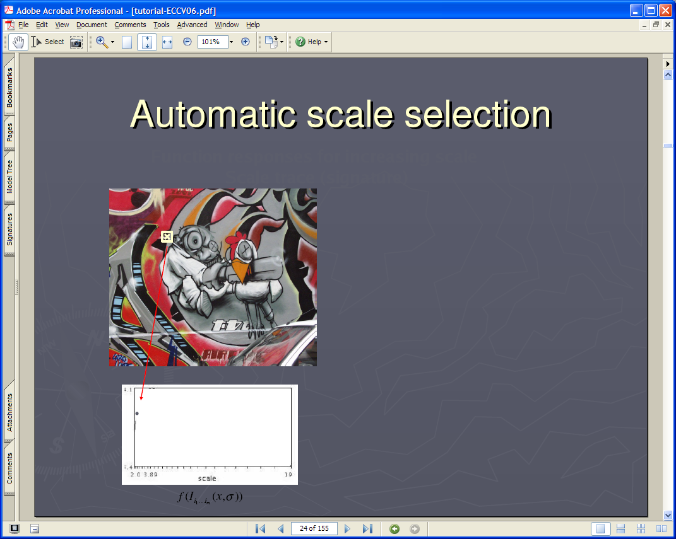
Lindeberg et al, 1996
Slide from Tinne Tuytelaars
Notes:
‹#›

Slide 33


Slide 34


Slide 35


Slide 36
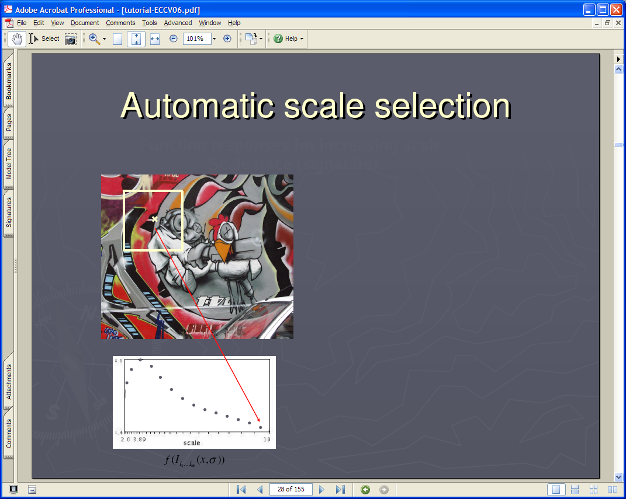
Notes:
‹#›
‹#›

Slide 37


Slide 38
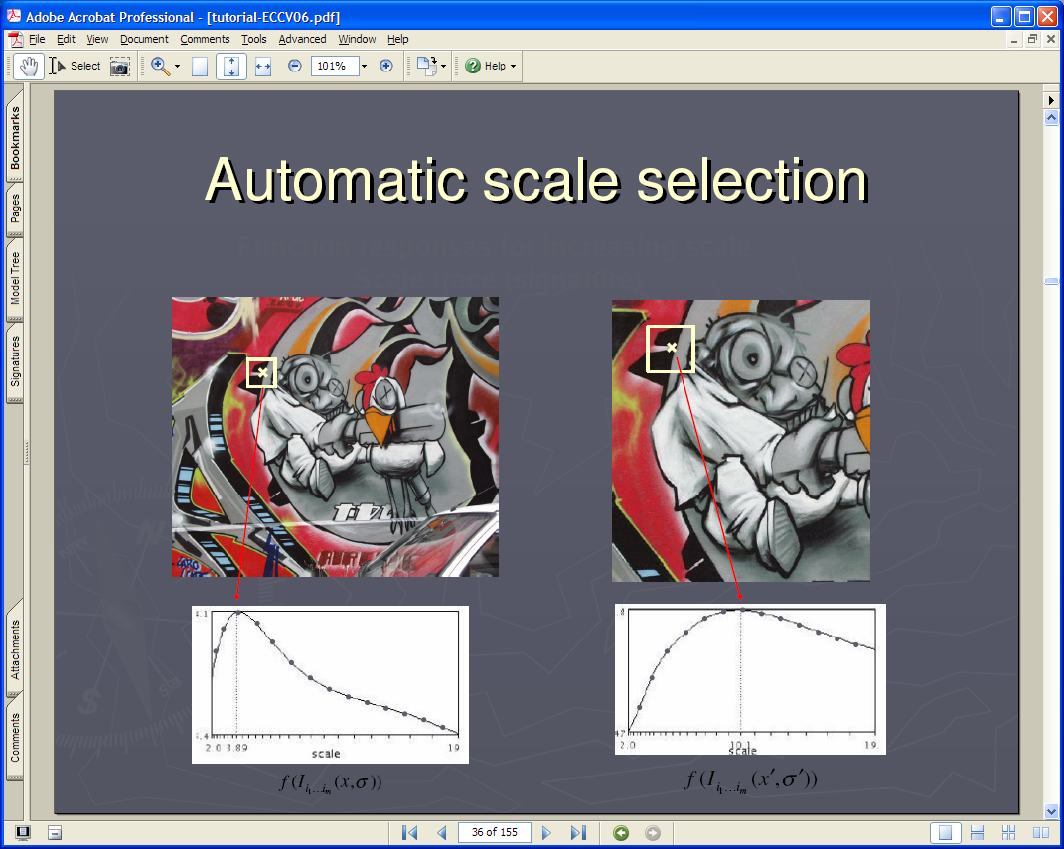
Notes:
‹#›
‹#›

Slide 39
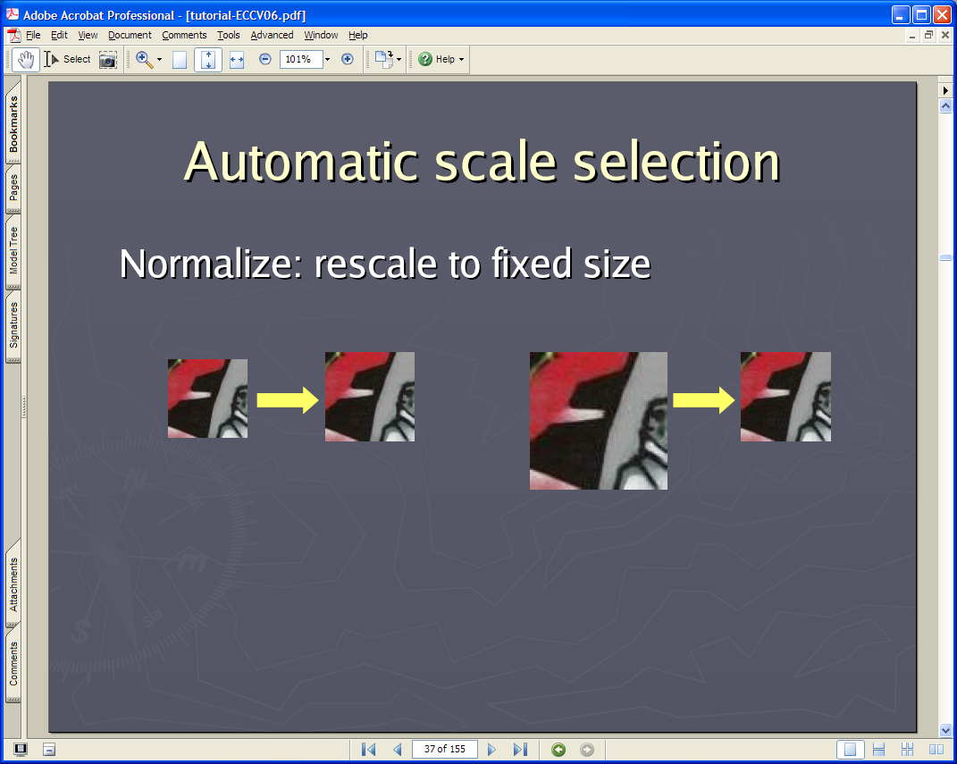
Notes:
‹#›
‹#›

Slide 40
Automatic Scale Selection (cont’d)
Using characteristic scale, the spatial extent of interest points becomes covariant to scale transformations.
The ratio σ₁/σ₂ reveals the scale factor between the images.
σ₁
σ₂
σ₁/σ₂ = 2.5
Notes:
‹#›
‹#›

Slide 41
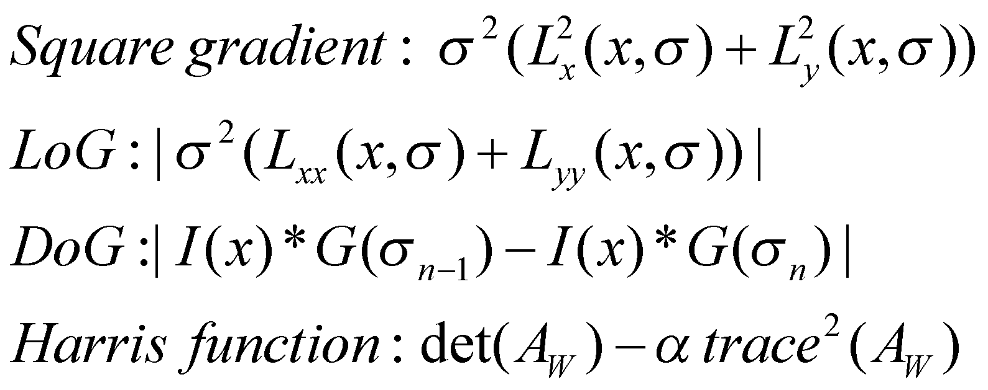
How to choose F(x,σ_{n}) ?
Typically, F(x,σ_{n}) is defined using derivatives, e.g.:
LoG (Laplacian of Gaussian) yielded best results in a recent evaluation study.
DoG (Difference of Gaussians) was second best.
C. Schmid, R. Mohr, and C. Bauckhage, "Evaluation of Interest Point Detectors",
International Journal of Computer Vision, 37(2), pp. 151-172, 2000.
Notes:
‹#›
‹#›

Slide 42
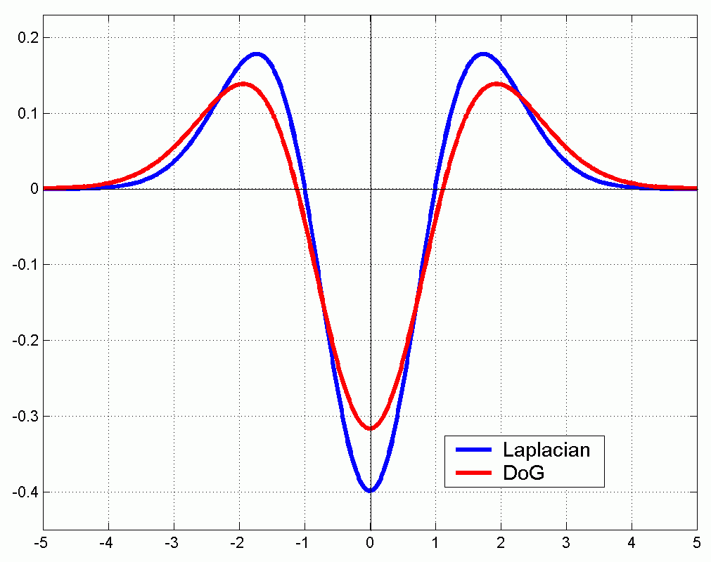
LoG and DoG
LoG can be approximated by DoG:
Notes:
‹#›
‹#›

Slide 43
Harris-Laplace Detector
Multi-scale Harris with scale selection.
Uses LoG maxima to find characteristic scale.
σ_{n}
scale
← LoG →
y
← Harris →
x

Slide 44
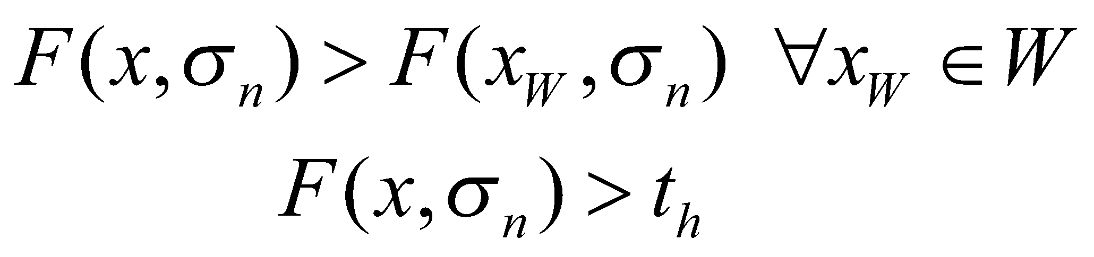
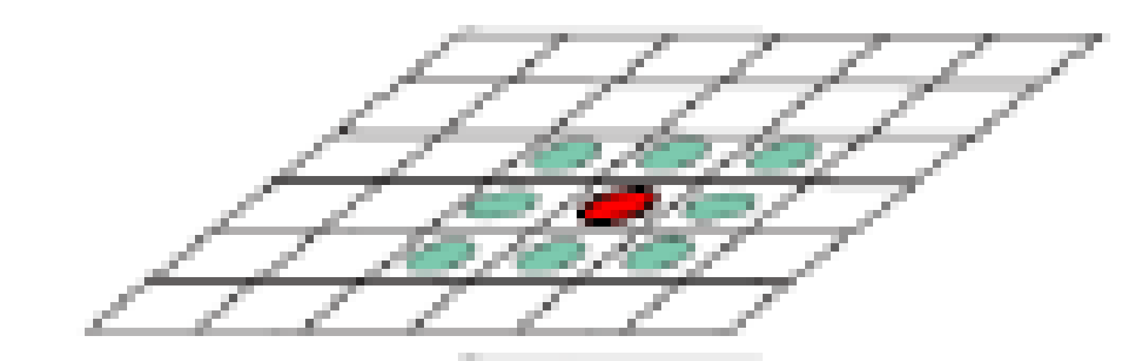
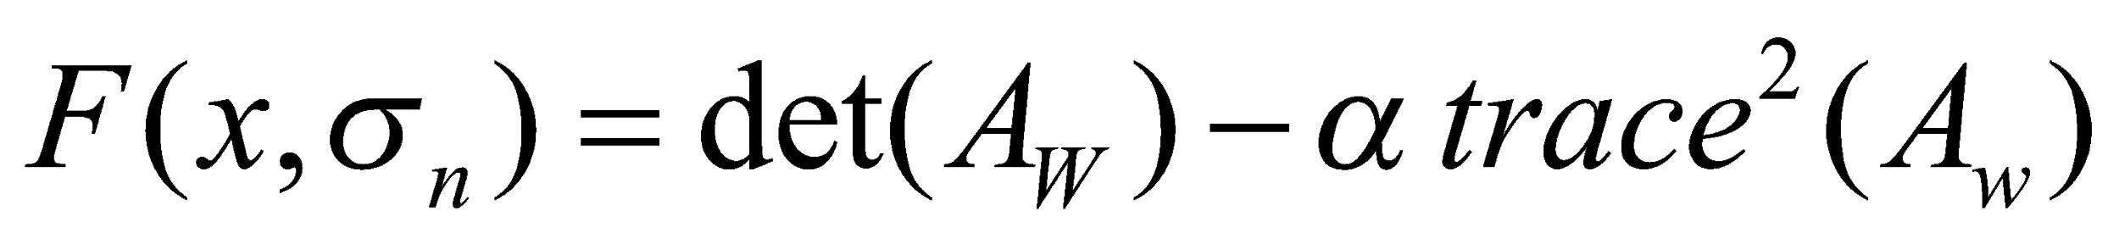
Harris-Laplace Detector (cont’d)
Find interest points at multiple scales using Harris detector.
- Scales are chosen as follows: σ_{n} =k^{n}σ
- At each scale, choose local maxima assuming 3 x 3 window
(i.e., non-maximal suppression)
where
(σ_{D} =σ_{n}, σ_{I} =γσ_{D} )
Notes:
‹#›
‹#›

Slide 45
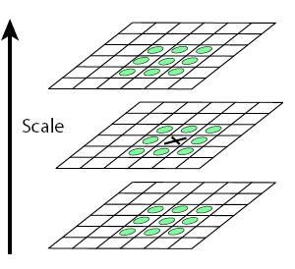
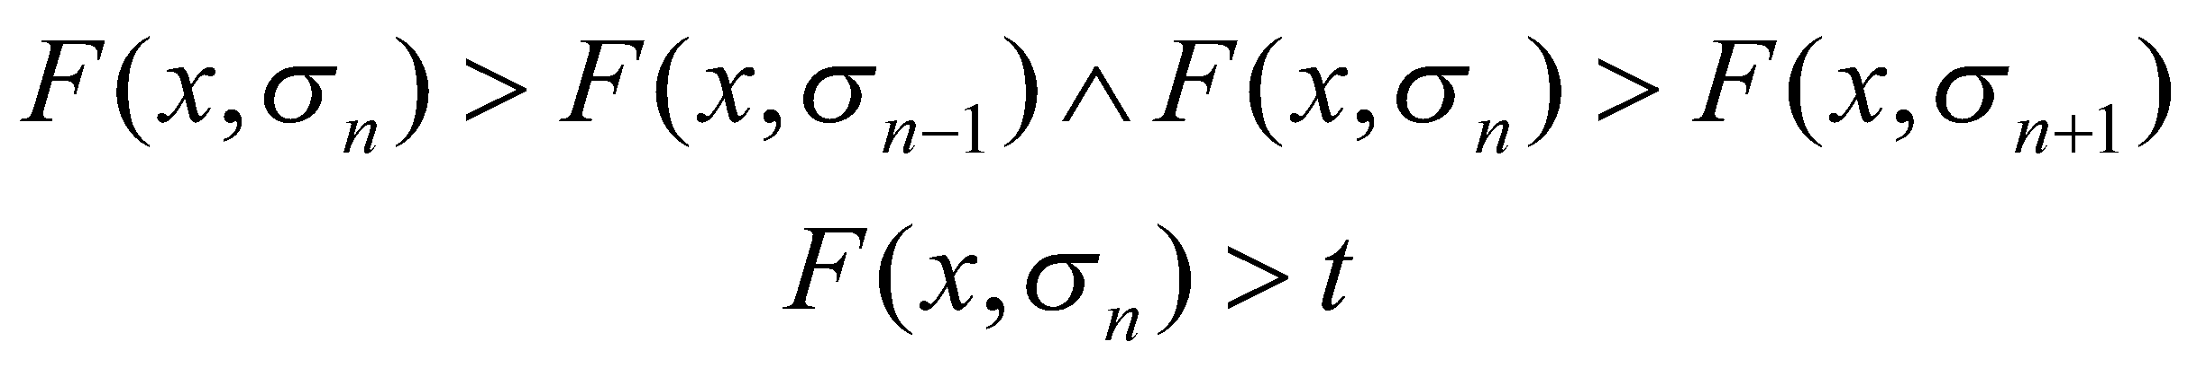
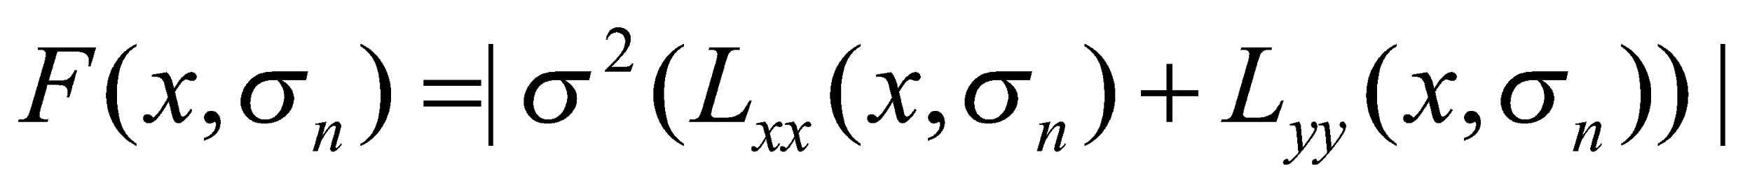
Harris-Laplace Detector (cont’d)
(2) Select points at which the normalized LoG is maximal across scales and the maximum is above a threshold.
σ_{n+1}
σ_{n}
where:
σ_{n-1}
K. Mikolajczyk and C. Schmid, “Indexing based on scale invariant interest points" IEEE Int. Conference on Computer Vision, pp 525-531, 2001.

Slide 46
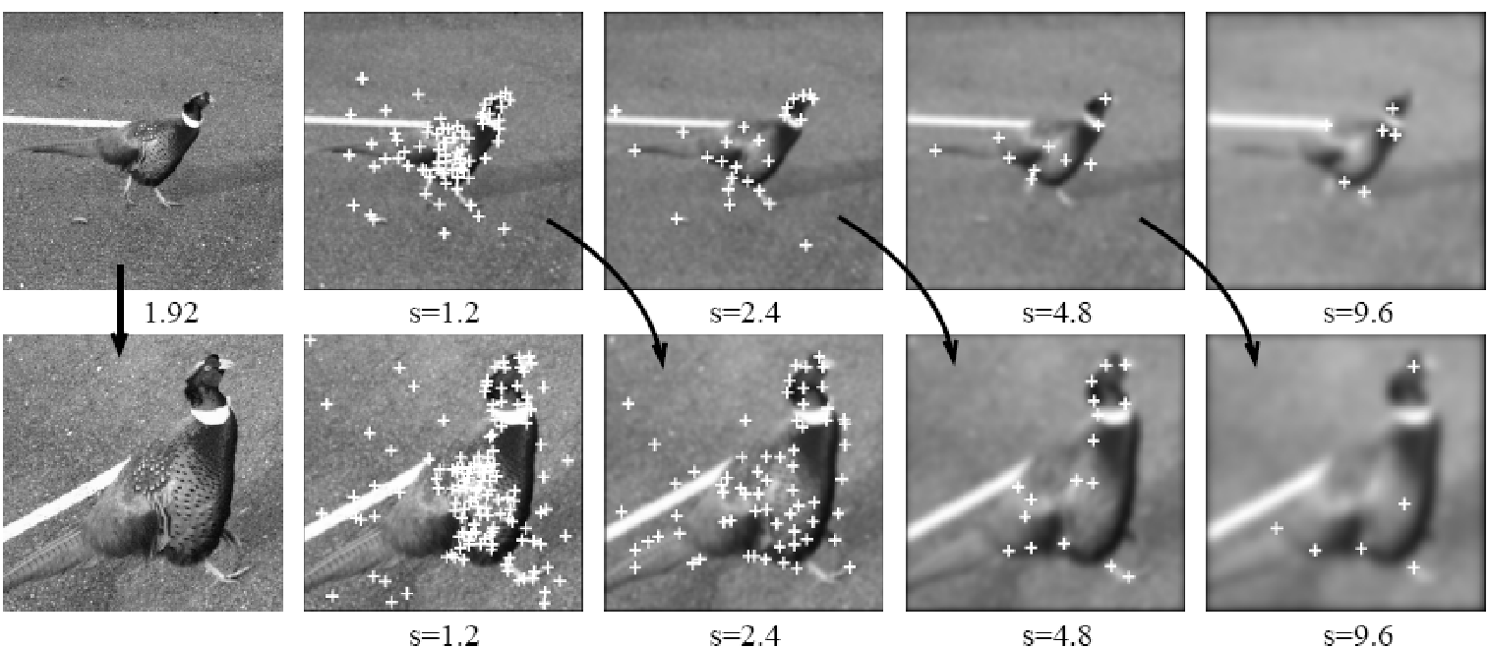
Example
Interest points detected at each scale using Harris-Laplace
Few correspondences between levels corresponding to same σ.
More correspondences between levels having a ratio of σ = 2.
images differ by a scale factor of 1.92
σ=1.2
σ=2.4
σ=4.8
σ=9.6
σ=1.2
σ=2.4
σ=4.8
σ=9.6
Notes:
‹#›

Slide 47
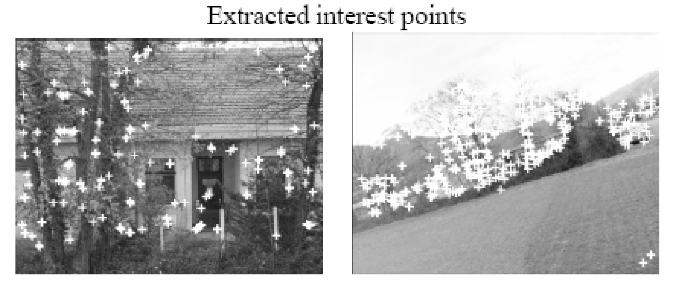
(Same viewpoint – change in focal length and orientation)
More than 2000 points would have been detected without scale selection.
Using scale selection, 190 and 213 points were detected in the left and right images, respectively.

Slide 48
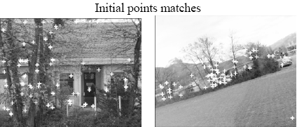
Example (cont’d)
58 points are initially matched (some were not correct)

Slide 49
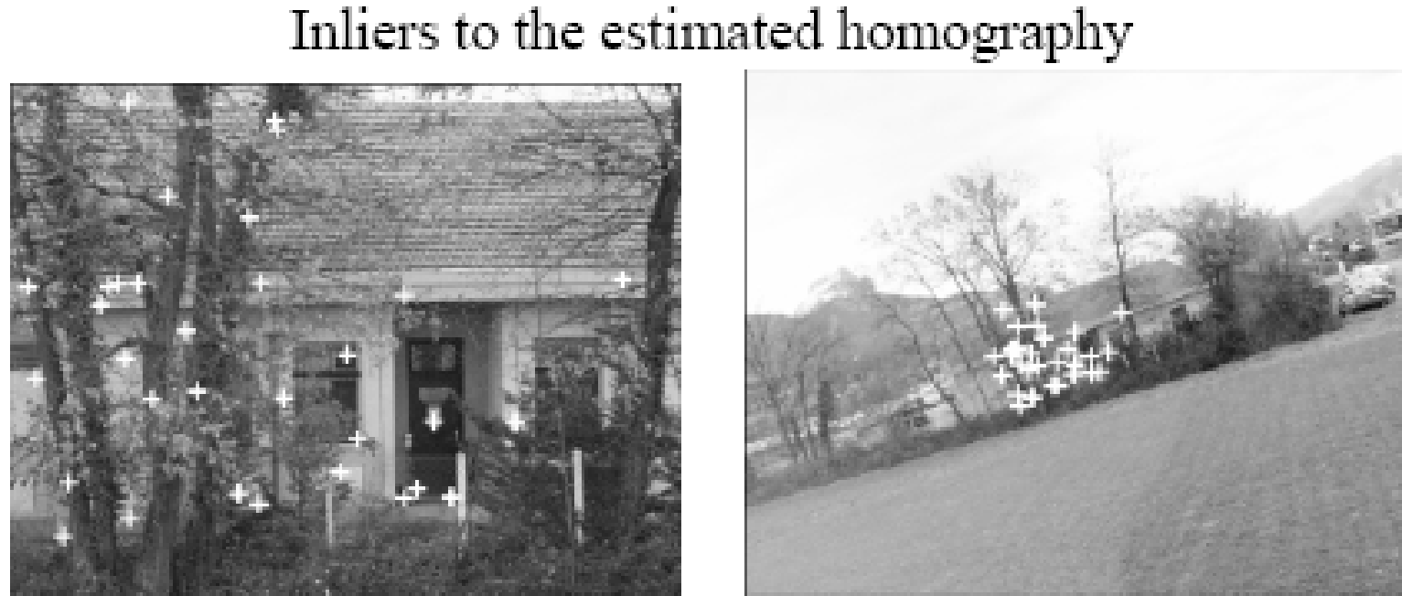
Example (cont’d)
Reject outliers (i.e., inconsistent matches) using RANSAC
Left with 32 matches, all of which are correct.
Estimated scale factor is 4:9 and rotation angle is 19 degrees.

Slide 50
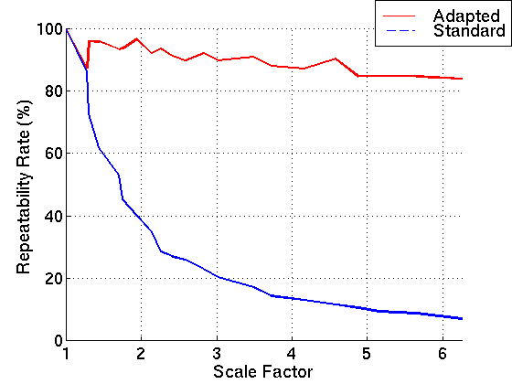
Harris-Laplace Detector (cont’d)
Invariant to:
Scale
Rotation
Translation
Robust to:
Illumination changes
Limited viewpoint changes
Repeatability

Slide 51
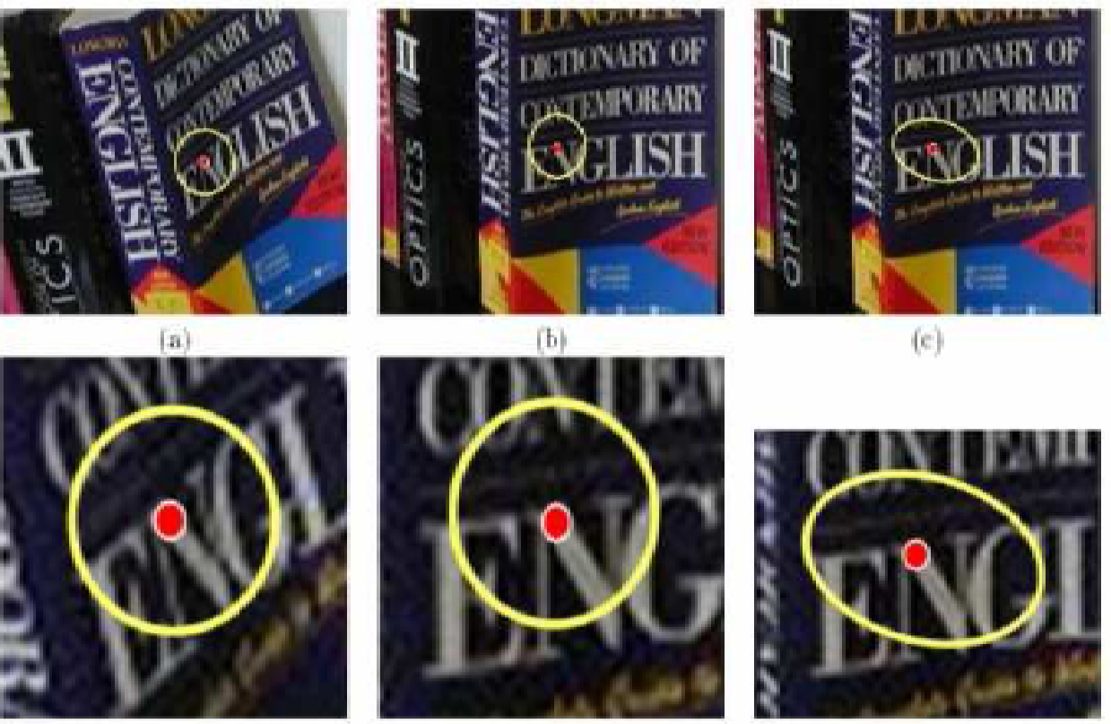
Handling Affine Changes
Similarity transformations cannot account for perspective distortions; affine could be used for planar surfaces.
Similarity transform
Affine transform

Slide 52
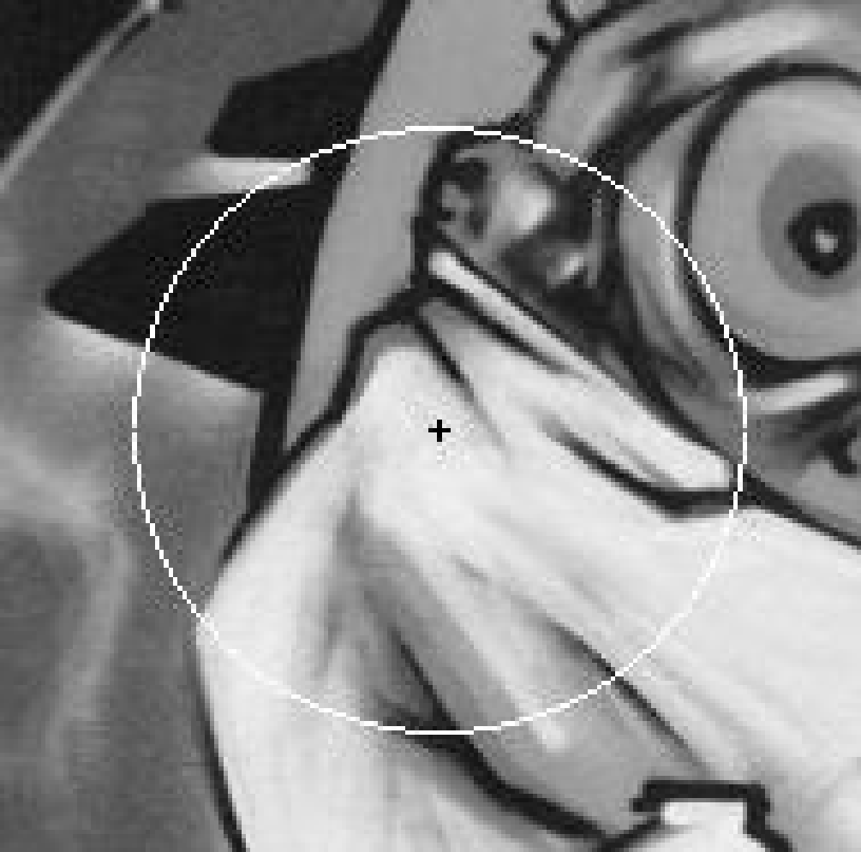

Harris Affine Detector
Use an iterative approach:
Extract approximate locations and scales using the Harris-Laplace detector.
For each point, modify the scale and shape of its neighborhood in an iterative fashion.
Converges to stable points that are covariant to affine transformations.
.

Slide 53
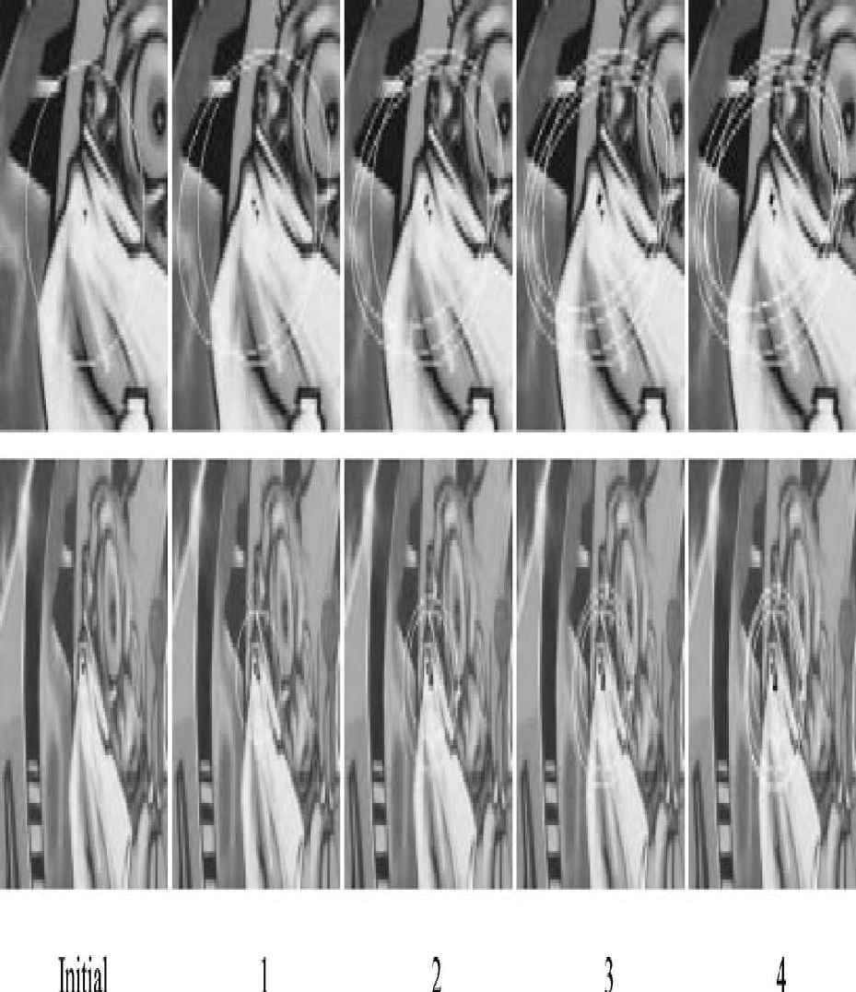
Steps of Iterative Affine Adaptation
1. Detect initial locations and neighborhood using Harris-Laplace.
2. Estimate affine shape of neighborhood using 2nd order moment matrix μ(x, σ_{I}, σ_{D}).

Slide 54
Steps of Iterative Affine Adaptation (cont’d)
3. Normalize (i.e., de-skew) the affine region by mapping it to a circular one (i.e., “remove” perspective distortions).
4. Re-detect the new location and scale in the normalized image.
5. Go to step 2 if the eigenvalues of μ(x, σ_{I}, σ_{D}) for the new point are not equal (i.e., not yet adapted to the characteristic shape).

Slide 55
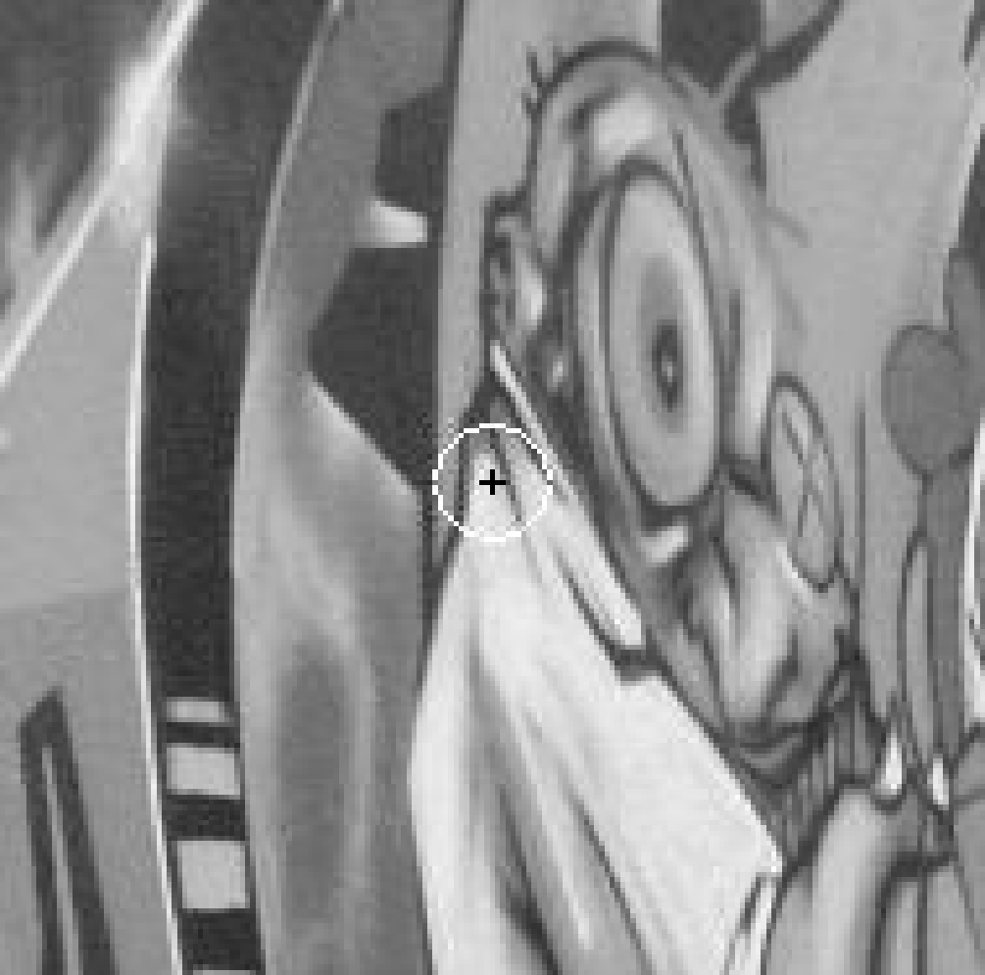
Iterative affine adaptation - Examples
Initial points
Example 1 Example 2

Slide 56

Iterative affine adaptation – Examples (cont’d)
Iteration #1
Example 1 Example 2

Slide 57
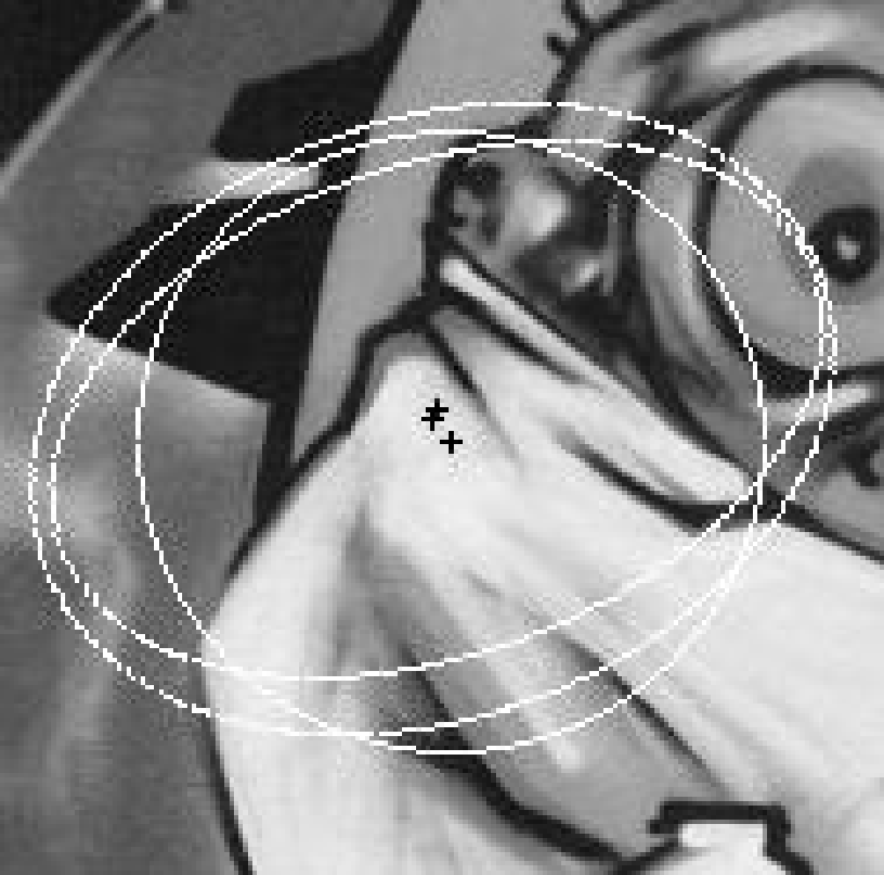

Iterative affine adaptation – Examples (cont’d)
Iteration #2
Example 1 Example 2

Slide 58
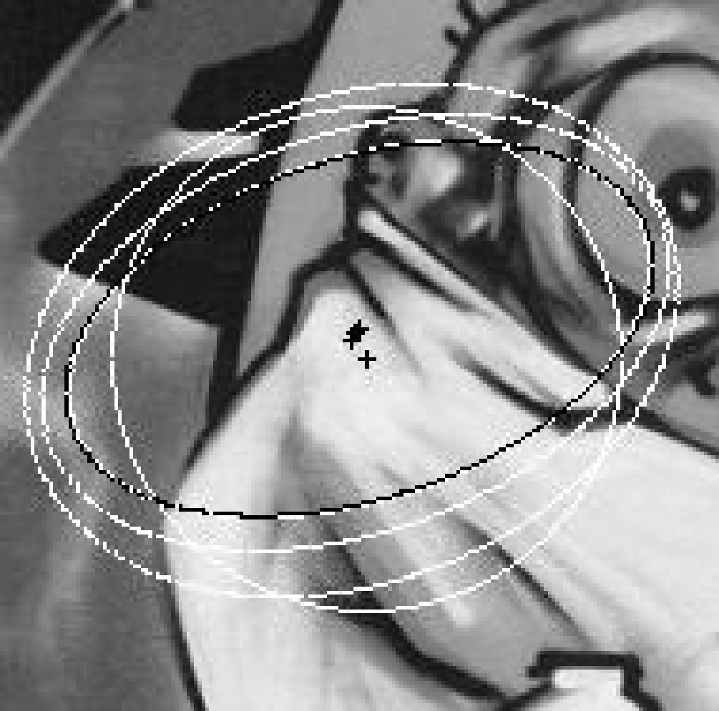

Iterative affine adaptation – Examples (cont’d)
Iteration #3, #4, …
Example 1 Example 2
K. Mikolajczyk and C. Schmid, “Scale and Affine invariant interest point detectors”,
International Journal of Computer Vision, 60(1), pp. 63-86, 2004.
http://www.robots.ox.ac.uk/~vgg/research/affine/

Slide 59
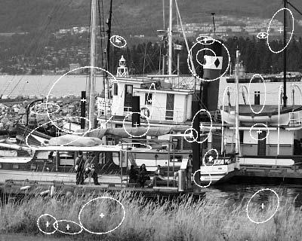



Iterative affine adaptation – Examples (cont’d)

Slide 60




De-skewing
Consider a point x_{L} with 2nd order matrix M_{L}
The de-skewing transformation
is defined as follows:
x_{L}

Slide 61



De-skewing corresponding regions
Consider two points x_{L} and x_{R} which are related through an affine transformation:
x_{L}
x_{R}

Slide 62




De-skewing corresponding regions (cont’d)
Normalized regions
are related by pure
rotation R.

Slide 63
2) Region Division
We use the intensity order based region division proposed by Fan [4].
Specifically, all the pixels in the local patch are first sorted by their intensities in a ascending order.
Then, the local patch is equally quantized into B ordinal bins according to their orders.

Slide 64

2) Region Division (contd.)
Figure(1) gives an illustration of such an intensity order based region division where each ordinal bin is marked with a different color.
Note that it is not only invariant to monotonic intensi-
ty changes and image rotation, but also contains much more spatial information than the ring-shaped region division

Slide 65
LIOP Descriptor
Let P^{N}={(p₁ , p₂, · · · , p_{N}) : p_{i} ∈ R} be the
set of N -dimensional vectors and Π^{N} the set of all possible permutations of integers {1, 2, · · · , N }, the mapping
γ :P ^{N} −→ Π ^{N}
^{γ(P) = π , P∈} P ^{N, π ∈} Π ^{N (1)}
where π = (i1 , i 2 , · · · , i N ) and pi1 ≤ pi2 ≤ · · · ≤ piN .
For a permutation π ∈ Π^{N} , its corresponding partition of P^{N} is:-
S(π) = {P : γ(P) = π, P ∈ P^{N} } (2)

Slide 67

LIOP:

Slide 68
BRIEF: Binary Robust Independent Elementary Features
Michael Calonder, Vincent Lepetit, Christoph Strecha, and Pascal Fua
CVLab, EPFL, Lausanne, Switzerland

Slide 69
Contributions
Pros:
Compact, easy-computed, highly discriminative
Fast matching using Hamming distance
Good recognition performance
Cons:
More sensitive to image distortions and transformations, in particular to in-plane rotation and scale change

Slide 70
Related work
Descriptors: SIFT, SURF, DAISY, etc
Descriptor + Dimension Reduction (e.g. PCA, LDA, etc)
Quantization
Hashing (e.g. Locality Sensitive Hashing)

Slide 71


Method
Binary test:
BRIEF descriptor:
Descriptor is a binary string of size nd where nd is generally 128,256,512.

Slide 72



How to choose (X,Y)
(X,Y)~i.i.d. Uniform
(X,Y)~i.i.d. Gaussian
X~i.i.d. Gaussian , Y~i.i.d. Gaussian

Slide 73
How to choose (X,Y)
And Randomly sampled from discrete locations of a coarse polar grid introducing a spatial quantization.and takes all possible values on a coarse polar grid containing points i.e fixing X as [0,0] Transpose

Slide 74
Basic Steps:
Basic Method Involves:
Smoothening the image using smoothening filters like gaussian filter
Finding the BRIEF descriptor value for every feature.
Finding the right match by using hamming distance to find common features between images

Slide 75

Smoothing kernels
De-noising
Gaussian kernels

Slide 76


Slide 77


Slide 78

Distance Distributions

Slide 79

Experiments

Slide 80
Future Work
Completing the main work of LIOP and BRIEF descriptor.
Trying out various different feature point detectors like SURF, FAST, Harris-affine..etc for both the descriptors and studying which is better
Experimenting with the results given in the paper verifying their results obtained

Slide 81
Work completed
Done preproccesing for LIOP descriptor and studied BRIEF implementation code and tried out both of the codes for some sample images added a some screenshots

Slide 82
Future

Slide 83
References For slides
C. Harris and M. Stephens. "A Combined Corner and Edge Detector”, Proceedings of the 4th Alvey Vision Conference: pages 147—151, 1988.

